Slide 1
Understanding assertions
What is Assertion in Python?
An Assertion in Python or a Python Assert Statement is one which asserts (or tests the trueness of) a condition in your code. This is a Boolean expression that confirms the Boolean output of a condition.
Why Assertion in Python is Used?
This is a debugging tool. If it finds the condition to be true, there is nothing it needs to do. So, it moves over to the next line of code. If not, it stops all operations and throws an error. It also shows the point of error in the code. The point of assertions in Python is to help deal with unrecoverable errors.

Slide 2
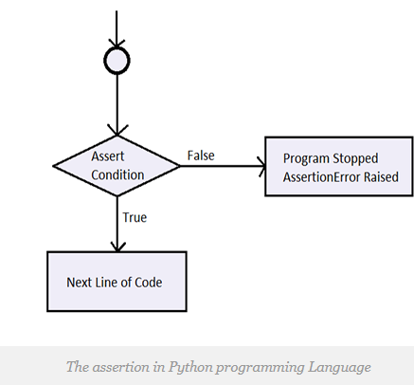

Slide 3
Python Assert Syntax
assert <condition>
assert <condition>, <error message>
Python Assert Example
>>> def div(p,q):
assert q!=0
return p/q
>>> div(2,3)
0.6666666666666666
>>> div(2,0)
Python assert statements help us make sure everything’s going fine with our code.

Slide 4
>>> assert 2==3
Since 2 not equal to 3
Hence assertion error arises
Div(2,2) no assertion error
Div(2,3) no assertion error
Div(2,0) assertion error arises
Since it is in p/q format where q not equal to zero.
Key Points to Remember
Assertions are the condition or boolean expression which are always supposed to be true in the code.

